Slide 1
Project Title: Exploratory Data Analysis (EDA) for Real Estate Pricing
By Riya Gadia

Slide 2
Introduction
The residential real estate market is dynamic and complex, posing challenges in determining optimal house prices.
Uncover patterns, correlations, and trends to enable informed decisions and strategic positioning of properties.

Slide 3
Objective
The ultimate objective is to empower the real estate company with a deeper understanding of the market forces at play. Your insights will guide the pricing strategy, facilitating better decision-making for property acquisition, sales, and negotiation. Moreover, your findings may uncover opportunities for optimizing property values, enhancing customer satisfaction, and gaining a competitive edge in a dynamic and ever-evolving real estate landscape

Slide 4
Methodology Overview
Data Collection: Gather comprehensive datasets containing information on property attributes, market trends, and economic indicators.
Exploratory Data Analysis (EDA): Utilize advanced analytics techniques to uncover insights and visualize data patterns.
Correlation Analysis: Identify relationships between house prices and various factors such as location, property features, and external economic indicators.
Visualization Tools: Leverage visualization tools to present findings in an accessible and compelling manner.

Slide 5
Data Analytics Approach
Advanced Techniques: Utilize machine learning algorithms, statistical analysis, and predictive modeling.
Visualization Tools: Employ tools such as matplotlib and seaborn for creating insightful visualizations.
Import necessary packages : In Python, Numpy is a package that includes multidimensional array objects as well as several derived objects.

Slide 6
Flow chart :
Start --> Collect Data --> Data Preprocessing --> Exploratory Data Analysis --> Split Data into Training and Test Sets
--> Implement Machine Learning Models --> Evaluate Model Performance --> Compare Models --> Select Best Model
--> Predict Property Prices --> End

Slide 7

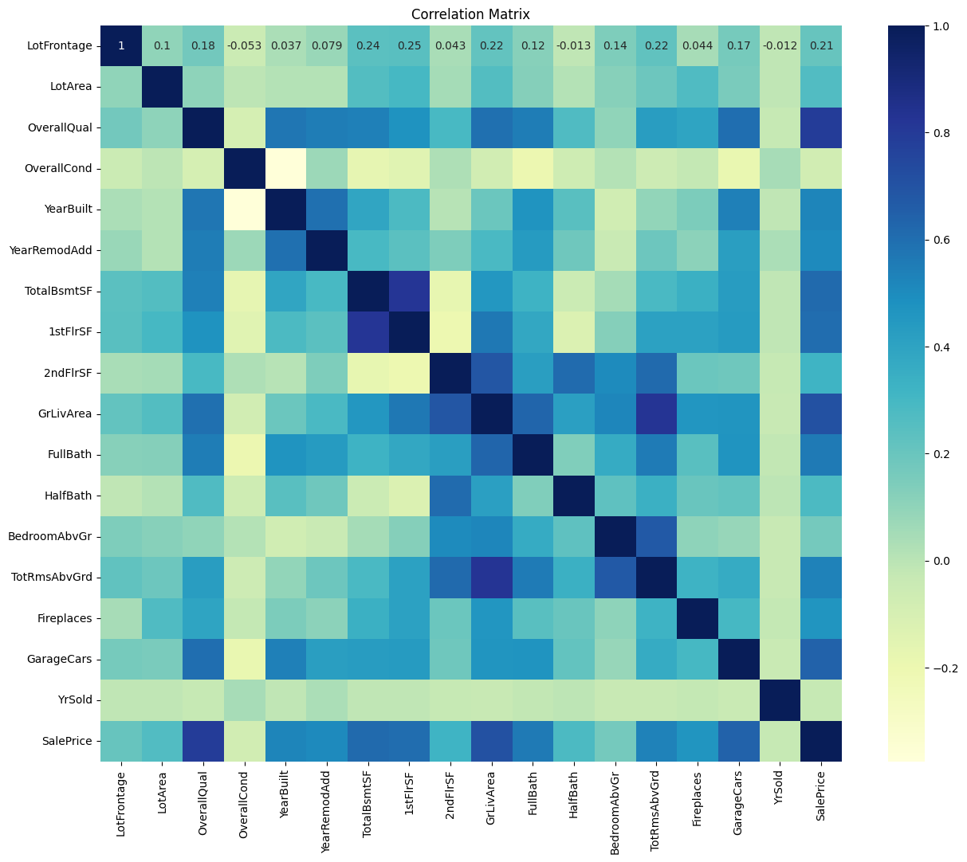
Correlation

Slide 8
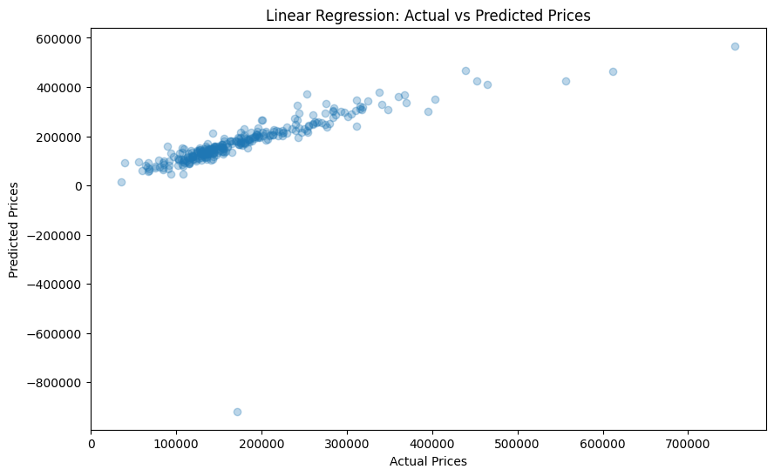
Linear Regression

Slide 9
Conclusion
In conclusion, our comprehensive analysis of residential real estate dynamics has provided valuable insights into the multifaceted nature of determining optimal house prices. By leveraging advanced data analytics techniques and visualization tools, we have successfully uncovered patterns, correlations, and trends within the dataset.
By incorporating data-driven strategies into our pricing and marketing efforts, we can better serve our clients and maintain a competitive edge in the ever-evolving real estate landscape.

